Slide 1
Motivation and Emotion
Notes:
Helps us understand why we do thinks like eat and drink and work and play and have sex, but also explains why some people are more driven to achieve than others
Emotions are a part of everything we do…they affect our decisions, our relationships with others and our health

Slide 2
Approaches to Understanding Motivation
Motivation is the process by which activities are started, directed, and continued so that physical or psychological needs or wants are met
Comes from the Latin word movere
Motivation is what moves people to do the things they do
Notes:
If you are hungry, you might be motivated to get up from your comfy spot on the couch in front of the telly to get something to eat.
If you are really hungry you might cook something, if you are really hungry but lazy, you might dial out for a pizza.
The point it were are motivated to do something when we feel hungry – we are programmed to feel uncomfortable when we are hungry and so we will eventually do something about it so that we can feel comfortable again.
Same goes for if your bladder is full.
Or if you are feeling sleepy.

Slide 3
Think-Pair-Share
What motivates you?
Why do you eat?
Why do you go to school?
Why do you maintain relationships?
With family?
With friends?
With boyfriends/girlfriends?
Why do you work?
Why do you play sports? Engage in a hobby?

Slide 4
Extrinsic Motivation
A person performs an action because of the potential external rewards that may be obtained as a result
Money for an ‘A’ on a report card
Bonus for good performance or ‘pay for performance’
Getting a tip for good service
What is the opposite of extrinsic motivation?
Notes:
When the motivation comes from outside the self – it is extrinsic
Sometimes there is an external reward, or you can avoid an unpleasant consequence (you unload the dishwasher because if you don’t your mom will lose her mind and yell at you!)
If you promise a kid a candy if they draw you picture, they will whip off a picture, slapdash, no details, because they are just doing it for the candy.
If you ask kids to draw a picture of something they love, they will create a masterpiece, full of details, because they are doing it to show you how much they love something

Slide 5
Intrinsic Motivation
Type of motivation in which a person performs an action because the act itself is rewarding or satisfying in some internal manner
What kinds of activities do you engage in just because…..
Notes:
Intrinsic motivation is the type of motivation where a person performs an action because the act itself is rewarding or satisfying in some internal way

Slide 6
Instinct Approaches
Approach to motivation that assumes that people are governed by instincts similar to those of other animals
Instinct to reproduce is responsible for sexual behaviour
Human behaviour is controlled by hereditary factors
Still a central idea in the study of human behaviour even if this approach has faded away
Notes:
Early researchers theorized that humans respond to their instincts in the same way that animals do – aggressive to protect their territory and mating because of innate patterns of behaviour.
They came up with lots of descriptions of all these instincts, there was no real attempt to explain why these instincts exist in humans – if at all.
e.g. “submissive people possess the instinct of submission”.
This approach has faded away because they describe behaviour but they cannot explain it.
It did force psychologists to realize that some human behaviour is controlled by hereditary factors.

Slide 7
Sociobiological Approach
Sociobiology states that natural selection favours social behaviours that maximize reproductive success
Thus, the primary motivating force for living organisms (including humans) is to pass on our genes from one generation to the next
This perspective can explain motives such as competition, aggression, sexual activity, and dominance

Slide 8
Drive-Reduction Approaches
Need – a requirement of some material (like food or water) that is essential for survival
Drive – a psychological tension and physical arousal arising when there is a need that motivates the organism to act in order to fulfill the need and reduce the tension
Notes:
When you have a need, it leads to psychological tension as well as physical arousal that motivates you to do something about it.
To fulfill the need and reduce the tension.
The tension that we feel, whether it is physical or psychological, is called a drive

Slide 9
Drive-reduction Theory
Approach to motivation that assumes that behaviour arises from physiological needs
Satisfy the need and reduce tension and arousal
Connection between internal physiological states and outward behaviour
I’m thirsty so I have a glass of water
Homeostasis
Notes:
Drive-reduction theory proposes just this connection between internal physiological states and outward behaviour.
This theory states that there are two kinds of drives….

Slide 10
Homeostasis
The tendency of the body to maintain a steady state
When there is a primary drive need, the body is in a state of imbalance, this stimulates behaviour that brings the body back in to balance or homeostasis
How is this like a thermostat?
Notes:
Homeostasis means that everything stays the same.
You could think of the concept of homeostasis as your bodies version of a thermostat – a thermostat keeps your house at a constant temperature, and homeostasis does the same for the body’s functions.
When there is a primary drive need, the body is in a state of imbalance.
We feel uncomfortable, and this stimulates behaviour that brings the body back into balance, or homeostasis

Slide 11
Primary vs. Secondary Drives
Primary drives are those that involve biological needs of the body such as hunger and thirst
Secondary (acquired) drives are those that are learned through experience or conditioning, such as the need for money or social approval
Notes:
Does this sound familiar?
It should….the concepts of primary and secondary reinforcers is very closes related.
Primary reinforcers satisfy primary drives and secondary reinforcers satisfy secondary drives.

Slide 12
Drive-Reduction Theory
Does not explain all motivation
Why do people eat when they are not hungry?
How do you explain thrill seeking behaviour?
Thrill seekers are increasing inner arousal, not reducing it!
Notes:
This theory works well to explain the actions people take to reduce tension created by needs, but it doesn’t explain everything
People don’t always seek to reduce their inner arousal – sometimes they seek to increase it!
Bungee jumping, watching horror movies, increase the inner state of tension and arousal and yet people engage in these behaviours….they love them.
Why do people do stuff like this if they don’t reduce some need or restore their body and mind to a state of homeostasis?
The answer is complex – there are a lot of theories that explore the other factors in motivation….
There are different types of needs, different effects of arousal, different incentives, and different levels of importance attached to many forms of behaviour.

Slide 13
Arousal Approaches to Motivation
Arousal theory says people are said to have an optimal (best or ideal) level of tension that they seek to maintain by increasing or decreasing stimulation
Task performances may suffer if the level of arousal is too high (severe anxiety) or if the level of arousal is too low (boredom)
Maintaining an optimal level of arousal may involve reducing tension or creating it
Notes:
People have an optimal level of arousal.
Task performance may suffer if the level of arousal is too high (severe anxiety) or even if the level of arousal is too low (boredom)

Slide 14
Yerkes-Dodson Law
Performance is related to arousal
Moderate levels of arousal lead to better performance than levels of arousal that are too high or too low
This effect varies with the difficulty of the task
Easy tasks require a high-moderate level
Difficult tasks require a low-moderate level
Notes:
Maintaining the optimal level of arousal may involve reducing tension or creating it
Students who experience test anxiety (a high level of arousal) may seek out ways of reducing anxiety in order to improve test performance (like studying for hours on end to improve test performance)
Students who have no test anxiety may not be motivated to study…lowering their performance
Most arousal theorist believe that the ideal level of arousal for most people in normal circumstances is somewhere in the middle – not too high and not too low

Slide 15
Sensation Seeker
Someone who needs more arousal than the average person to feel content
Linked to greater risk-taking behaviour
http://www.bbc.co.uk/science/humanbody/mind/surveys/sensation/
Notes:
Sensation seekers seem to need to have more complex and varied sensory experiences than do other people
Doesn’t always have to involve danger per se
People who travel to foreign countries to study for example, might score higher on a sensation seeking scale than a person who chooses to stay at home to study.

Slide 16
Consistency Theory
When internal thoughts differ and conflict, it results in a creation of tension
Tension is the driving force for change in behaviour to reduce the tension
Reduction in tension returns us to homeostasis
We are motivated to make things consistent

Slide 17
Needs: Need for Acheivment
How to succeed by excelling at everything!
nAch
A strong desire to succeed in attaining goals, not only realistic ones, but also challenging ones
Achievement motivation appears to be strongly related to success in school and work
Notes:
Harvard University psychologist David C. McClelland proposed a theory of motivation that highlights the importance of three psychology needs not typically considered by the other theories: achievement, affiliation, and power.
People who are high in nAch look for careers and hobbies that allow other people to evaluate them because these high achievers also need to have feedback about their performance in addition to the achievement of reaching the goal.
Some become wealthy or famous or whatever, but some do it just for the challenge.
Strongly related to success in school and occupational success.

Slide 18
Needs: Need for Affiliation
Popularity Rules!
nAff
The need for friendly interactions and relationships with others
People with this need seek to be liked by others and to be held in high regard by those around them
Makes good team players
Notes:
A person high in achievement might just run over the team members on their way to the top, or the net!

Slide 19
Needs: Need for Power
The One Who Dies with the Most Toys Wins
nPow
The need to have control or influence over others and to have an impact on others
Status and prestige are more important than achievement
Notes:
Power is not about reaching the goal, but about having control over other people.
People high in this need want to have influence over others and make an impact on them.
They want their ideas to be the ones that are used, regardless of whether their ideas will lead to success.
Status and prestige are important so they wear expensive clothes, drive fancy cars, dine in the best restaurants.
Someone who is a high achiever may not need a lot of money to validate their achievement, someone who is high in the need for power typically sees the money (and the cars, and the jewelry and other toys) as the achievement.
The subtitle is a bumper sticker, and its kind of funny, but it is really a negative comment about the need for power.
For someone high in this need, its all about who has the best and most expensive toys at the end.

Slide 20
Incentive Approaches to Motivation
Theories of motivation in which behaviour is explained as a response to the external stimulus and its rewarding properties
Rewarding properties exist independently of any need or level of arousal and can cause people to act only upon the incentive
Notes:
Still doesn’t explain the motivation behind all behaviour
Many theorist see it as a result of both the push of internal needs and the pull of the rewarding external stimulus
This might explain why when we feel hungry, we choose to satisfy the hunger with a bag of chips instead of an apple

Slide 21
Humanistic Approaches to Motivation
Maslow’s Hierarchy of Needs
Maslow proposed that there are several levels of needs that a person must strive to meet before achieving the highest level of personality fulfillment
According to Maslow, self-actualization is the point where people have satisfied the lower needs and achieved their full human potential

Slide 22
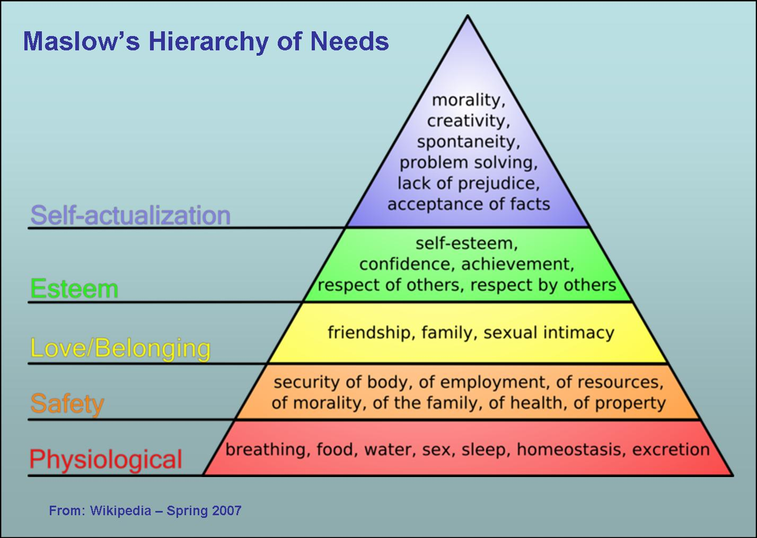
Notes:
Deficiency needs are those needs of the body – need for food and water
Growth needs are desires such as having frineds or feeling good about oneself
Maslow believed that for a person to adhieve selfa actualiazion, which is the highest level of growth needs, the primary basic needs must first be fulfilled
Castaway = volleyball

Slide 23
Emotion

Slide 24
Emotion - 3 elements
There are 3 elements
The ‘feeling’ aspect of consciousness, characterized by (1) a certain physical arousal, (2) a certain behaviour that reveals that feeling to the rest of the world, and(3) an inner awareness of feelings

Slide 25
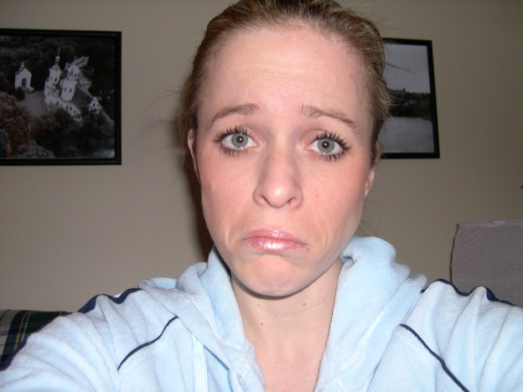
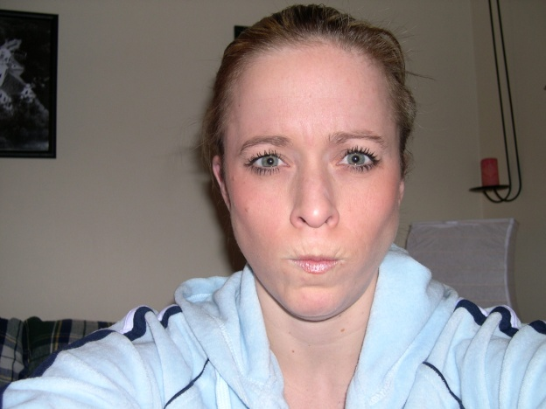
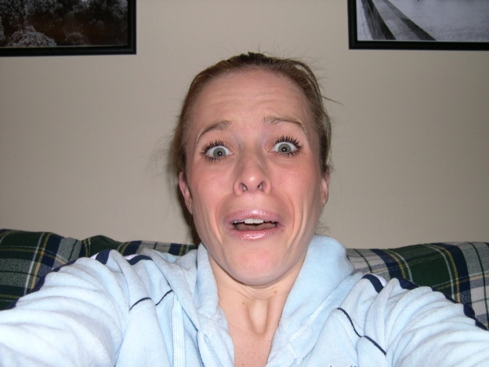
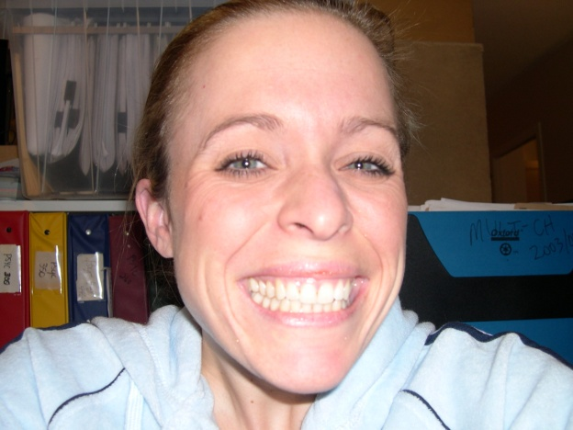


EMOTIONS
IDENTIFY THE EMOTIONS:

Slide 26
The Physiology of Emotion
When you experience an emotion, you also experience a corresponding arousal created by the sympathetic nervous system
Flight or fight response - heart rate increases, breathing becomes more rapid, the pupils dilate, and mouth may become dry
Hormone secretion

Slide 27
The Behaviour of Emotion
Facial expressions
Voice characteristics
Body language
Stance or posture
Spot the Fake Smile

Slide 28
Labelling Emotion
Interpreting the subjective feeling by giving it a label (anger, fear, disgust, etc.)
Cognitive component
Labelling process is a matter of retrieving memories of similar experiences, perceiving the context of the emotion and coming up with a solution – a label
Influenced by language and culture
That's Disgusting

Slide 29
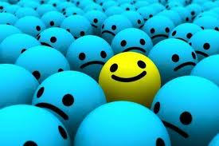
Theories of Emotion

Slide 30
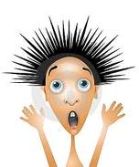
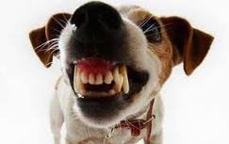
Common Sense Theory “I’m shaking because I’m afraid”
Stimulus
First Response
Second Response
Fear!
Snarling Dog
ANS Arousal
Conscious Fear
Theory in which a stimulus leads to an emotion which leads to a physiological reaction

Slide 31
James-Lange Theory “I’m afraid because I’m shaking”
Stimulus
First Response
Second Response
Fear!
Snarling Dog
ANS Arousal, Changes in body
Conscious Fear
Theory in which a stimulus leads to a physiological reaction which leads to the labelling of an emotion

Slide 32
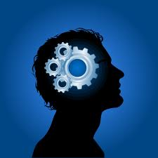
Cannon-Bard Theory “I’m shaking and feeling afraid at the same time”
Stimulus
First Response
Second Response
ANS Arousal, Changes in body
Snarling Dog
Subcortical Brain Activity
Fear!
Theory in which a stimulus is interpreted by the brain and causes the physiological reaction and the emotion simultaneously
Conscious Fear

Slide 33
Schacter & Singer’s Cognitive Arousal Theory “This snarling dog is dangerous and that makes me feel afraid”
First Response
Stimulus
Second Response
Cognitive Appraisal
Fear!
Snarling Dog
Conscious Fear
ANS Arousal, Changes in body
Theory in which a stimulus causes a cognitive appraisal and a physiological reaction simultaneously and this leads to the emotional reaction

Slide 34
Facial Feedback Hypothesis
Fear!
ANS Arousal and
Facial Expression
Conscious Fear
Cognitive interpretation
of face motions
Snarling Dog
Theory in which a stimulus causes a physiological reaction and a facial expression. The facial expression provides feedback to the brain about the emotion. The brain interprets the emotion and may intensify it.

Slide 35
Lazarus – Cognitive Mediational Theory
Fear!
Snarling Dog
Conscious Fear
Bodily Response
Appraisal of threat
Theory in which a stimulus must be interpreted (appraised) by the brain to result in a physiological reaction and then an emotion

